Slide 1
English Comprehension
Bring Out The Joy Of Reading
Grade 5-6
www.astrojr.com

Slide 2
Contents
What is English Comprehension and its importance
Sequencing
Cause And Effect
Compare And Contrast
Story Element
Main Idea
Passages
www.astrojr.com

Slide 3
Continuation…
Fact v/s Fiction
Inferencing and Problem Solving
Self Questioning
Summarizing (Drawing Conclusions)
www.astrojr.com

Slide 4
Introduction
www.astrojr.com

Slide 5

Comprehension is the understanding and interpretation of what is read.
To be able to accurately understand written material, children need to be able to
(1) decode what they read;
(2) make connections between what they read and what they already know; and
(3) think deeply about what they have read
What is English Comprehension?
www.astrojr.com

Slide 6
Reading comprehension is one of the most important aspects of English literacy.
Without proper comprehension skills, students lack the ability to understand what they read. Having excellent reading comprehension skills is crucial.
It increases the enjoyment and effectiveness of reading and helps not only academically, but professionally, and in a person's personal life.
A well-developed reading comprehension skillset allows people to quickly read and understand text, from novels and textbooks to newspaper or magazine articles.
Importance of Reading Comprehension
www.astrojr.com

Slide 7

Let’s Begin With Chapter 1
Compare And Contrast
www.astrojr.com

Slide 8

The ability to compare and contrast is one of the first higher-order reading comprehension skills students are introduced to. Compare, in relation to reading, refers to the process of identifying the similarities and differences between two things. On the other hand, Contrast refers to identifying only the differences between two things.
Compare & Contrast acts as a practical and easy-to-use introduction to higher-order thinking. It improves comprehension by highlighting important details, making abstract ideas more concrete, and reducing the confusion between related concepts.
www.astrojr.com

Slide 9
Learning About The Solar System
1
Read The Following Passages And Answer The Questions On Compare And Contrast.
When scientists looked at the stars long ago, they saw patterns. They did not understand everything about what they saw, so they kept looking in order to learn more. That is what scientists do. They ask questions and search for information to answer their questions. They are similar to explorers. While they do not travel far the way explorers do, they do make a kind of journey. Scientists want to learn more, so their journey is to travel from what they know to what they discover.
Scientists have learned many facts about our planet. They’ve discovered that it is incredibly diverse, with many different kinds of environments. There are both places that are extremely hot and spots that are freezing. There are mountains and plains, hills and valleys. There are deep oceans and there are great rivers and waterfalls. There are tropical rainforests and arid deserts. Those are all various parts of our planet. Still, there is much more to learn about what is here on Earth, particularly what is under the oceans. Scientists still are exploring this planet. A scientist dedicates much time to learning, first how to research, then using those skills to learn about the world. The scientist works hard to help us all become more knowledgeable about our world. Research is the key to learning more.
www.astrojr.com

Slide 10
Continuation…
Our planet is in a galaxy called the Milky Way. The sun is a big star in our part of this giant galaxy, but our galaxy holds millions of other stars. The sun is very important to our planet because it provides light during the day, and gives us heat, too. Two other planets are closer to the sun than Earth: Mercury and Venus. Each planet has its own characteristics. We have learned more about them by studying the solar system with telescopes and spacecraft. Unmanned spacecraft have taken scientific instruments as far away as the planet Mars. There they found similarities to Earth, including kinds of land formations such as mountains as well as other features, and a landscape that seems to be the same rocky surface on most of that red planet, but they have not found any life forms on that barren planet.
Scientists figured out how the Earth changes. Earth orbits the sun once each year, which means it travels once around the sun every 365 days. The other eight planets in our solar system also orbit around the sun. All travel in a pattern called an ellipse, which is a type of oval. Therefore, at times, Earth is farther from the sun. Scientists figured out that the farther Earth was from the sun, the cooler the planet was. They also figured out that it is the tilt of the Earth’s axis, however, that has the greatest effect on temperatures.
www.astrojr.com

Slide 11
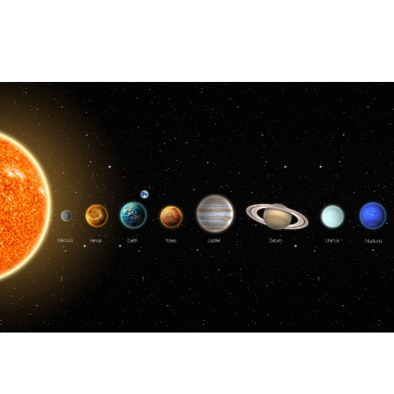
Continuation…
Scientists are still learning about our galaxy. There will always be new things to discover. Today astronauts travel into space; they are explorers. Long ago, explorers used to travel the sea and map places no one had been before. Now, astronauts travel in ships—spacecraft-- thousands of miles in space, where still much is unknown. While it is dangerous to travel in space, astronauts are dauntless and bravely travel thousands of miles just to learn. They bring skills with technology and research and courage to their work.
www.astrojr.com

Slide 12

Now, Answer The Following Questions.
www.astrojr.com

Slide 13
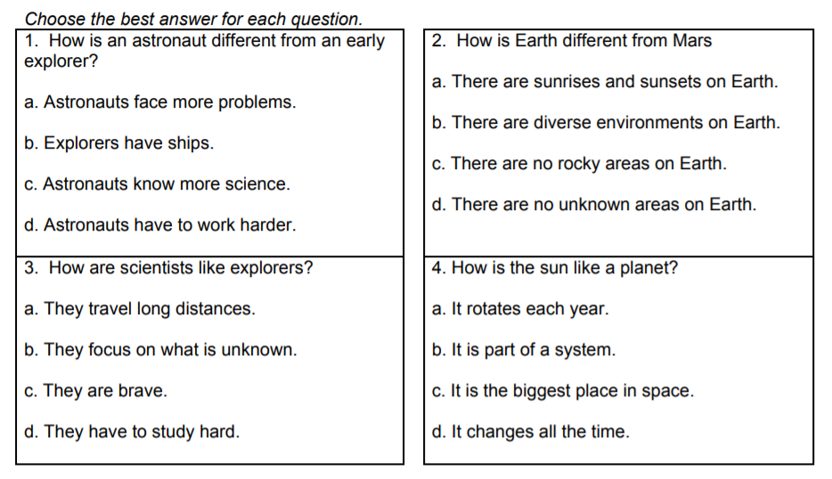
Choose the best answer for each question.
How is Earth different from Mars? Contrast.
What are the similarities between the Earth and Mars? Compare.
Write down the pros and cons of space travel.
Write your own answer to this question in the next page. How are today’s astronauts like early explorers?
www.astrojr.com

Slide 14
Brown Recluse Spider
2
Read The Following Passages And Answer The Questions On Compare And Contrast.
The brown recluse spider gets its name from its drab brown coloring and its habit of living a solitary existence. These spiders are characterized by a violin-shaped marking on the back of the neck. While many spiders have eight eyes, the Brown recluse has six eyes organized into three "dyads." Brown recluse spiders are small spiders rarely exceeding 3/8 of an inch in length.
These spiders are most common in the southern plains states of Kansas, Missouri, Oklahoma, Arkansas, Texas, Louisiana and Alabama. They are also established in Illinois, Indiana, Ohio, Kentucky, and Tennessee. This spider loves dark places and is normally found in log piles, old tires, or in drains. Inside the house, brown recluse spiders may be found in dark basements, closets, or in trash cans.
Brown recluse spiders will bite humans when threatened, although their bite is only powerful enough to puncture skin; it cannot bite through clothing. Although different people will experience a wide range of intensity of symptoms (some will experience little pain or minor symptoms while other experience intense pain and symptoms), a brown recluse spider bite normally requires medical attention, although there is currently no anti-venom for a bite from
www.astrojr.com

Slide 15
Continuation…
this spider. Some individuals (about 10% of those who are bitten) experience major tissue damage, necrosis (decay of skin and tissue) and infection as a result of a bite from this spider. In rare cases, individuals require the amputation of the affected limb.
The black widow spider is characterized by its black body and legs, and tell-tale red hourglass marking on the underside of its abdomen. Females can grow to lengths of about 1.5 inches. Males are smaller but have longer legs.
The black widow spider is one of the most feared spiders in the world. Its venom is extremely poisonous and is said to be at least 15 times more poisonous than the venom of a rattlesnake. Black widow spiders are found in many parts of the world, but in the United States are limited to the warmer climates of the southern and western portions of the county. Black widow spiders are fond of dark places such as under rocks or logs. In houses and buildings, they may take up residence in closets, furniture, pipes, or in basements. After a female and a male mate, the female often kills and eats the male, hence the name black "widow."
Black widow spiders eat other insects that they catch in their webs. Unlucky victims are injected with venom which liquefies their insides. The spider can then easily consume its prey.
www.astrojr.com

Slide 16
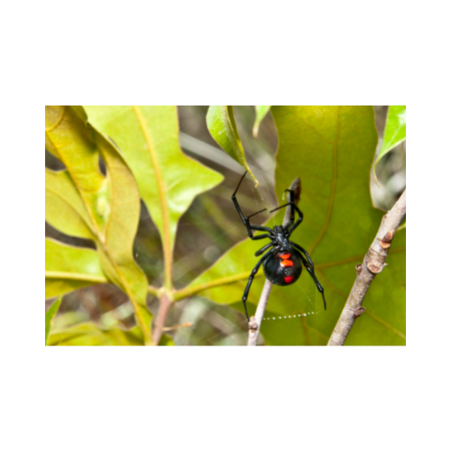
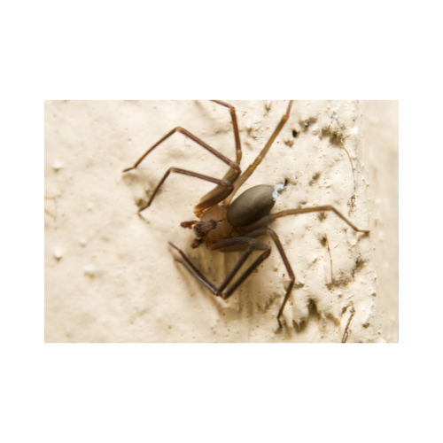
Continuation…
Black widow spiders will bite humans when they feel threatened. While the venom is not toxic enough to normally cause death, it is extremely painful, and is often severe enough to require hospitalization. Headaches, chest or abdominal pain, muscle cramps, and trouble breathing are the most common symptoms.
Brown Recluse Spider
Black Widow Spider
www.astrojr.com

Slide 17
Now, Answer The Following Questions.
www.astrojr.com

Slide 18
Choose the best answer for each question.
3. Write down the similarities and differences between the Recluse spider and the Black Widow.
1. Which of the following do both kinds of spider have in common?
They are both about the same size
They both live in dark places
They both have red hourglass markings
They are both the same color
4. What is described below?
I saw a dark-colored spider in my trash can. It was about an inch and a half long. It looked like it might have some red marking on its belly.
2. What makes the brown recluse spider different from most spiders?
1. They live in the southern United States
They have less eyes than most spider
The bite of the brown recluse is more powerful than that of most spiders
They are larger than most spiders
www.astrojr.com

Slide 19
Continuation...
NOTES
1. Female brown recluse spider
Male black widow spider
Male brown recluse spider
Female black widow spider
Which of the following best describes why the brown recluse spider has “recluse” in its name?
1. These spiders live alone and rarely associate with other brown recluse spiders.
Its venom is so toxic that in some cases it causes people to lose limbs
It is drab and plain-colored, which makes it look relatively harmless
The spider is often found in dark places, under logs, and in basements
www.astrojr.com

Slide 20
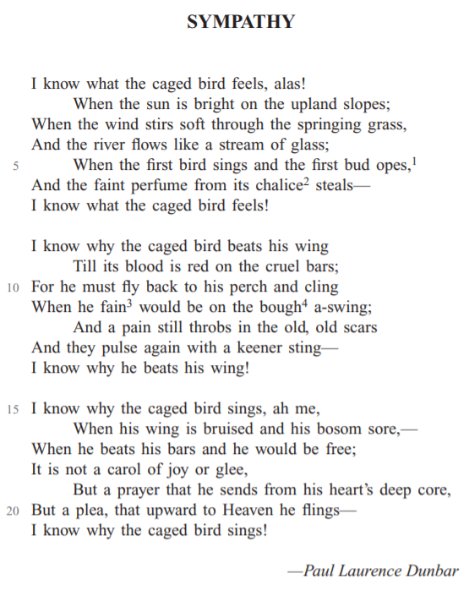

SYMPATHY
3
Paul Laurence Dunbar was an African American poet who wrote in the late 1800s and early 1900s.
His poem “Sympathy” speaks of the feelings of a bird in a cage.
Read the poem and answer the questions that follow.
www.astrojr.com

